Slide 1
Measuring Clustering Quality
Clustering Evaluation: Evaluating how good the clustering results are
  No commonly recognized best suitable measure in practice
Extrinsic vs. intrinsic methods: depending on whether ground truth is used
  Ground truth: the ideal clustering built by using human experts
Extrinsic: Supervised, employ criteria not inherent to the dataset
  Compare a clustering against prior or expert-specified knowledge (i.e., the ground truth) using certain clustering quality measure
Intrinsic: Unsupervised, criteria derived from data itself
  Evaluate the goodness of a clustering by considering how well the clusters are separated and how compact the clusters are (e.g., silhouette coefficient)

Slide 2
General Criteria for Measuring Clustering Quality with Extrinsic Methods
Given the ground truth Cg, Q(C, Cg) is the quality measure for a clustering C
Q(C, Cg) is good if it satisfies the following four essential criteria
  Cluster homogeneity: the purer, the better
  Cluster completeness: assign objects belonging to the same category in the ground truth to the same cluster
  Rag bag better than alien: when an object doesn't clearly fit into a well-defined cluster (heterogeneous object), it's better to place it in a more general or miscellaneous category (the "rag bag") than to force it into a specific pure cluster, where it may not belong.
  Small cluster preservation: splitting a small category into pieces is more harmful than splitting a large category into pieces
Ground truth partitioning G₁
G₂
Cluster C₁
Cluster C₂

Slide 3
General Criteria for Measuring Clustering Quality with Extrinsic Methods
Given the ground truth Cg, Q(C, Cg) is the quality measure for a clustering C
Q(C, Cg) is good if it satisfies the following four essential criteria
  Cluster homogeneity: The purer, the better. Objects in the same cluster should be similar.
  Cluster completeness: Same category, same cluster. Objects of the same type in the ground truth should end up in the same cluster.
  Rag bag better than alien: If an object doesn’t fit well anywhere, it’s better to put it in a “miscellaneous” group than in the wrong cluster.
  Small cluster preservation: Don’t split small categories. Breaking small groups is worse than breaking large ones.
Ground truth partitioning G₁
G₂
Cluster C₁
Cluster C₂

Slide 4
Commonly Used Extrinsic Methods
Ground truth partitioning G₁
G₂
Matching-based methods
  Examine how well the clustering results match the ground truth in partitioning the objects in the data set
Information theory-based methods
  Compare the distribution of the clustering results and that of the ground truth
  Information theory (e.g., entropy) used to quantify the comparison
  Ex. Conditional entropy, normalized mutual information (NMI)
Pairwise comparison-based methods
  Treat each group in the ground truth as a class, and then check the pairwise consistency of the objects in the clustering results
  Ex. Four possibilities: TP, FN, FP, TN; Jaccard coefficient
Cluster C₁
Cluster C₂

Slide 5
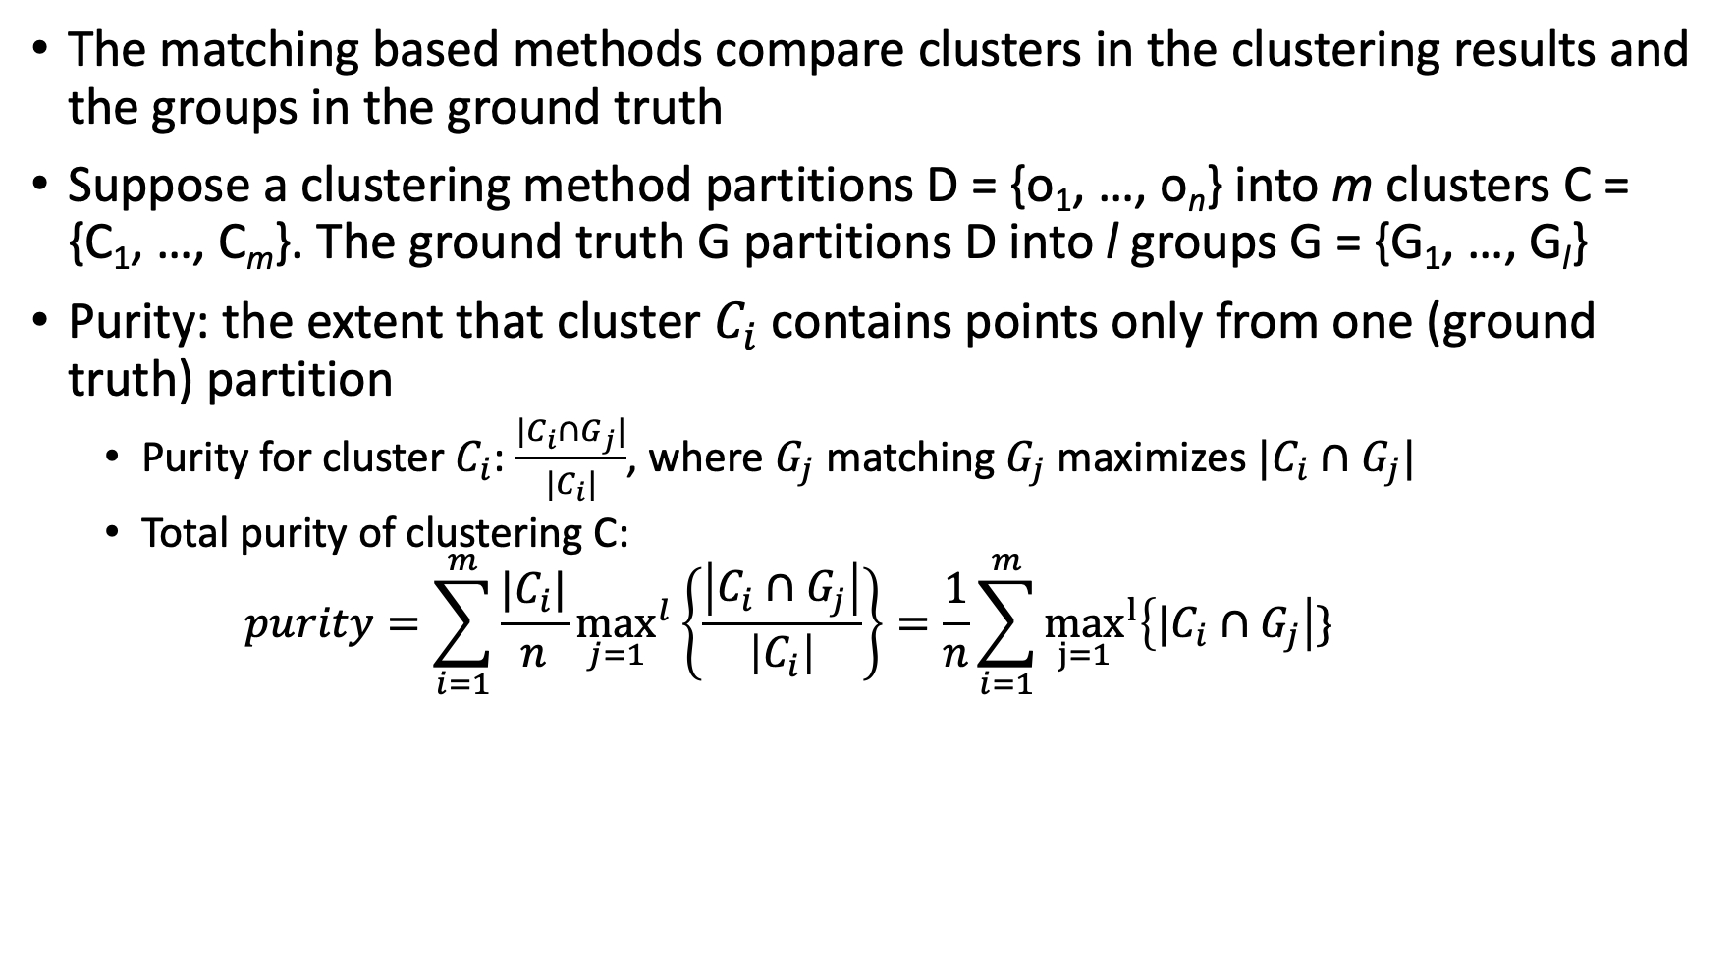
Matching-Based Methods
Ground Truth G₁
G₂
G₃
Cluster C₁
C₂
C₃

Slide 6
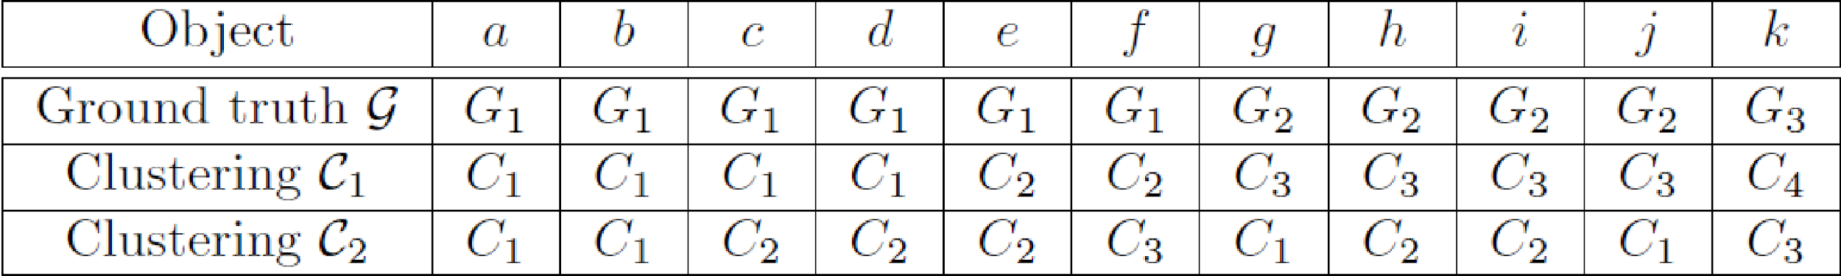
Matching-Based Methods: Example
Ground Truth G₁
G₂
G₃
Cluster C₁
C₂
C₃
Consider 11 objects
Purity for clustering C₁ = 1/11 (4 + 2 + 4 + 1) = 11/11 = 1;
Purity for clustering C₂ = 1/11 (2 + 3 + 1) = 6/11

Slide 7
Information Theory-Based Methods (I)
Conditional Entropy
Ground Truth G₁
G₂
G₃
Cluster C₁
C₂
C₃
A clustering can be regarded as a compressed representation of a given set of objects
The better the clustering results approach the ground-truth, the less amount of information is needed
This idea leads to the use of conditional entropy

Slide 8
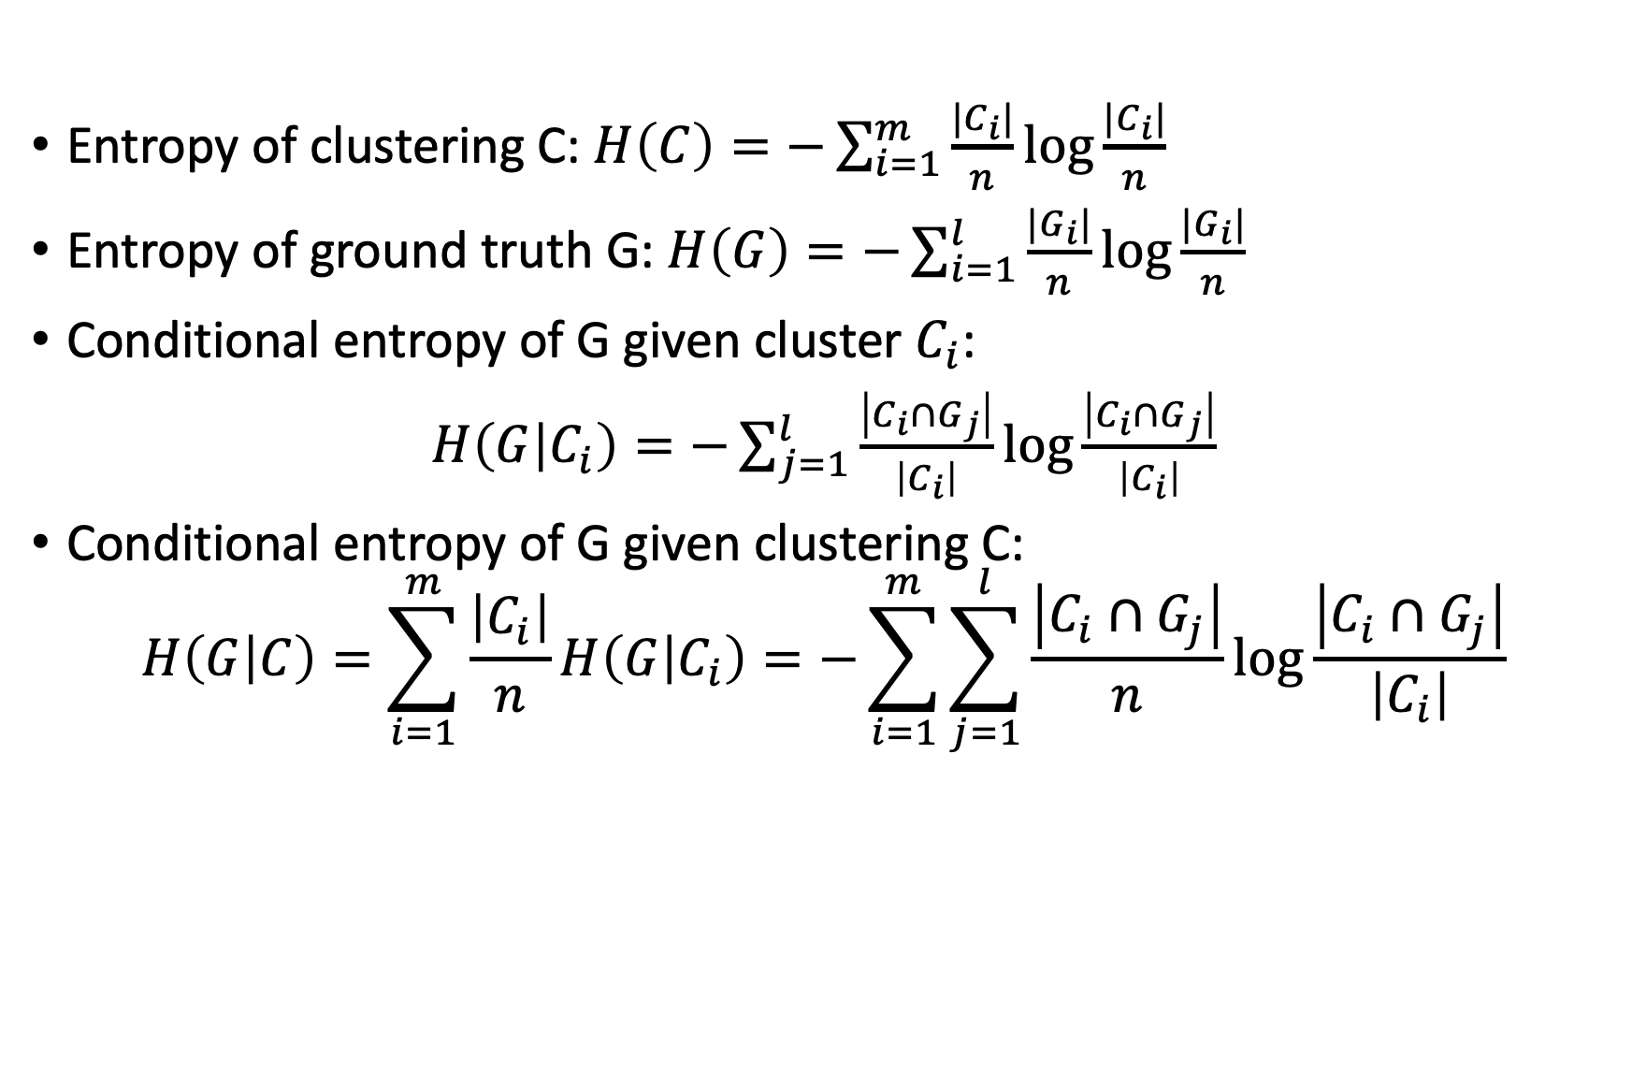
Information Theory-Based Methods (I)
Conditional Entropy
Ground Truth G₁
G₂
G₃
Cluster C₁
C₂
C₃

Slide 9
Example
Ground Truth G₁
G₂
G₃
Cluster C₁
C₂
C₃
Consider 11 objects
Purity for clustering C₁ = 1/11 (4 + 2 + 4 + 1) = 11/11 = 1;
Purity for clustering C₂ = 1/11 (2 + 3 + 1) = 6/11
Note: conditional entropy cannot detect the issue that C₁ splits the objects in G into two clusters

Slide 10
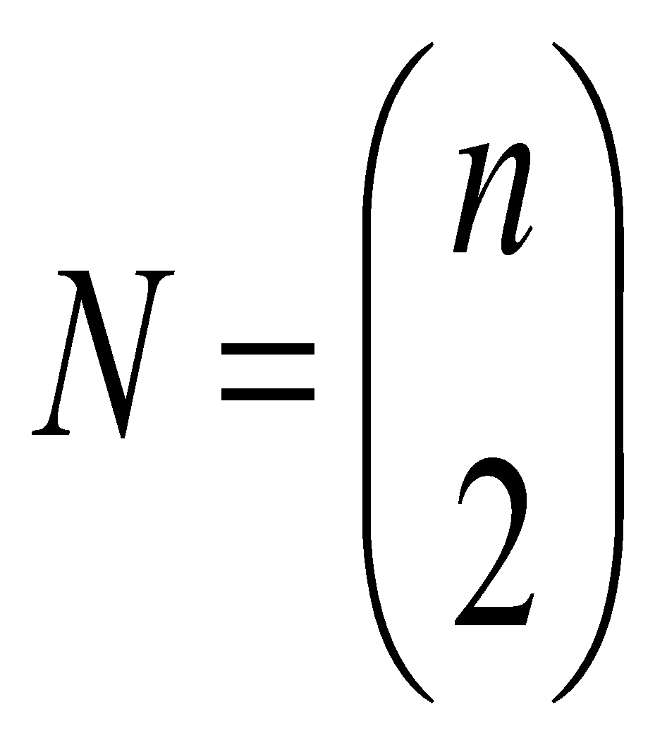
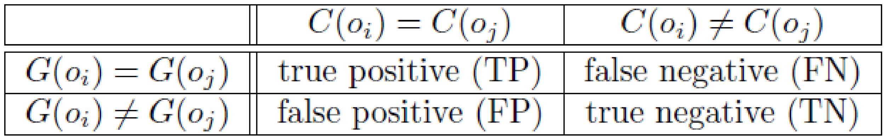
Pairwise Comparison-Based Methods: Jaccard Coefficient
Pairwise comparison: treat each group in the ground truth as a class
For each pair of objects (o_{i}, o_{j}) in D, if they are assigned to the same cluster/group, the assignment is regarded as positive; otherwise, negative
  Depending on assignments, we have four possible cases:
  Jaccard coefficient: Ignoring the true negatives (thus asymmetric)
  Jaccard = TP/(TP + FN + FP) [i.e., denominator ignores TN]
    Jaccard = 1 if perfect clustering
Many other measures are based on the pairwise comparison statistics:
  Rand statistic
  Fowlkes-Mallows measure
Note: Total # of pairs of points

